Slide 1
House Price Prediction
Team Id:- Team_3827
College Name:- GIDC Degree Engineering College,Abrama
Team Leader:- Renil Patel
Team Members:-Krunal Patel,
Lokesh Deshmukh,
Ayush Patel, Aryan Patel.

Slide 2

AGENDA
PROBLEM STATEMENT
PROJECT OVERVIEW
WHO ARE THE END USERS?
THE WOW FACTOR IN OUR SOLUTION
MODELLING
RESULTS
CONCLUSION

Slide 3
PROBLEM STATEMENT
The aim of this project is to build a predictive model that can accurately estimate the selling price of house in a particular geographic area. The model will be based on a range of features, including location, size, age, and amenities, and will be trained on a dataset of historical property sales.
The model will be evaluated on a test dataset to assess its accuracy and will be deployed in a production environment to allow stakeholders to use it to make predictions. The project will provide valuable insights into the factors that drive house prices in the target area and will help buyers and sellers to make informed decisions about real estate transactions.

Slide 4
PROJECT OVERVIEW
The house price prediction project is a machine learning project that aims to build a predictive model to estimate the selling price of residential properties in a particular geographic area. The project will involve collecting and preprocessing a dataset of historical property sales, identifying the relevant features that impact house prices, and selecting and training an appropriate machine learning algorithm to build the predictive model.

Slide 5




Who Are The Users End User?
Real Estate Companies
Civil Engineers
Architectures

Slide 6
THE WOW FACTOR IN OUR SOLUTION
- Very easy to use.
It predict accurate Price Based on Input Features.
Accurate Price Prediction
User Friendly
- The Business man can Make Big Profit by Investing Money that Houses whose Price is less than the model Predict.
Time Saving
More Profitable Model

Slide 7
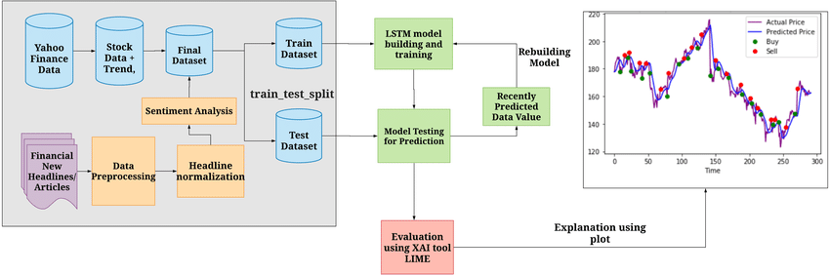
MODELING

Slide 8
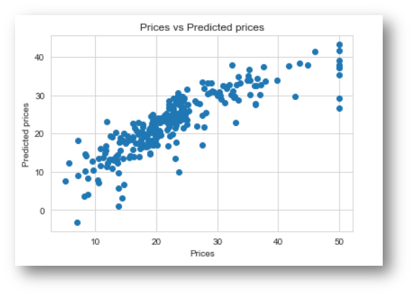

Results
Git Repo :
https://github.com/renilpatel18/house_price_pridiction

Slide 9

CONCLUSION
In conclusion, this project aims to build a machine learning model that can predict house prices based on their features. The model will be evaluated and compared using various performance metrics, and the results will be presented in a clear and understandable format.
The project can be useful for real estate agents, homeowners, and buyers who want to make informed decisions about the value of properties.

Slide 10






MEET OUR TEAM
Renil Patel
Krunal Patel
Lokesh Deshmukh
Aryan Patel
Ayush Patel

Slide 11

Thank you !! 😊

